Slide 1

Week 2 Project
Shuoheng Zhang

Slide 2
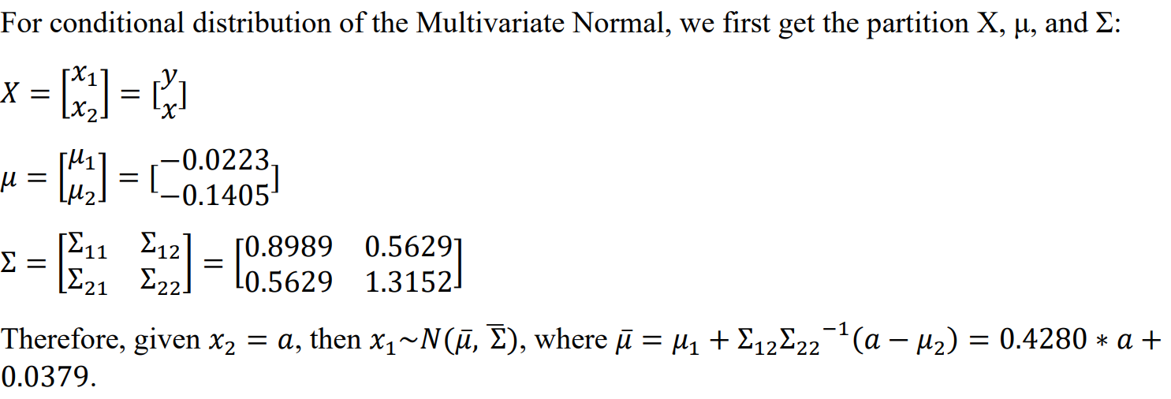
Problem 1

Slide 3
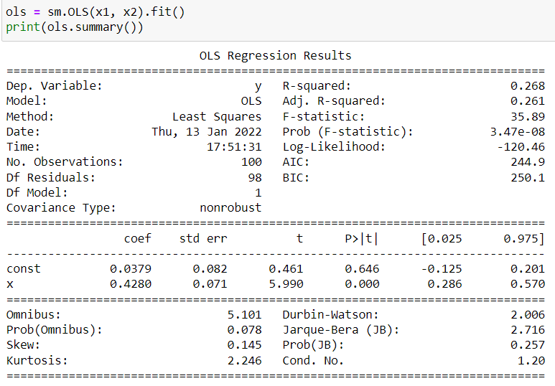
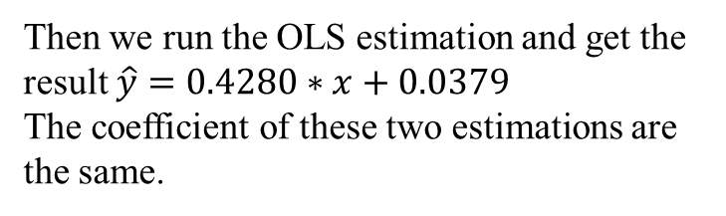
Problem 1
Then we run the OLS estimation and get the result $\hat{y}=0.4280∗x+0.0379$
The coefficient of these two estimations are the same.

Slide 4
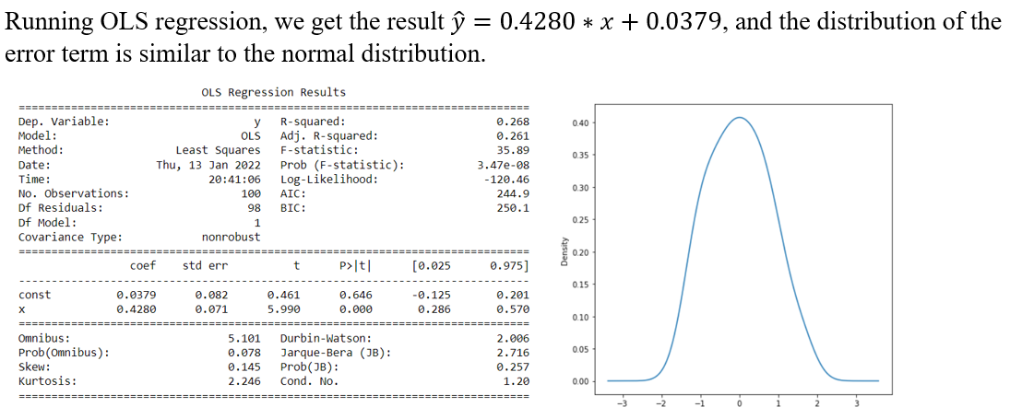
Problem 2

Slide 5
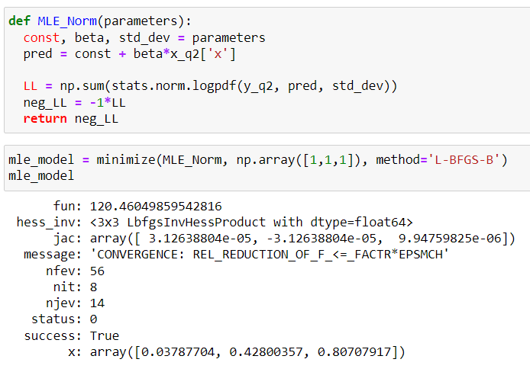
Problem 2
The result is same as the OLS result, which means that MLE fits the assumption of normality.

Slide 6
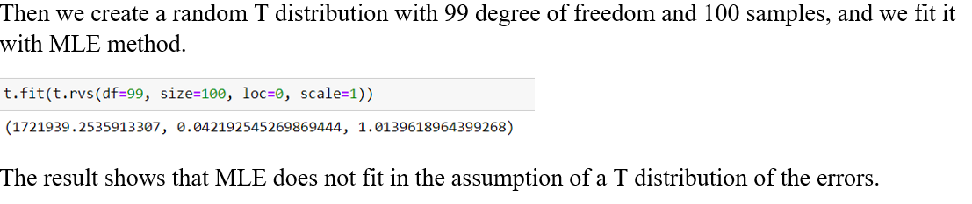
Problem 2

Slide 7

Problem 2
Then we compare the moments of the regression with the normal distribution, we get mean = -0.141, standard deviation = 1.141, skewness = 0.145, kurtosis = 2.246, which are close to the standard normal.
If the normality assumption breaks, $E\left[y_{i}\right]= β_{0}+β_{1}x_{i}+ε_{i}$ will be biased because $E[ε_{i}]≠0$, which will make the estimation invalid.

Slide 8
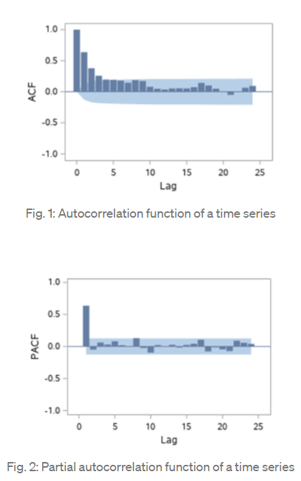
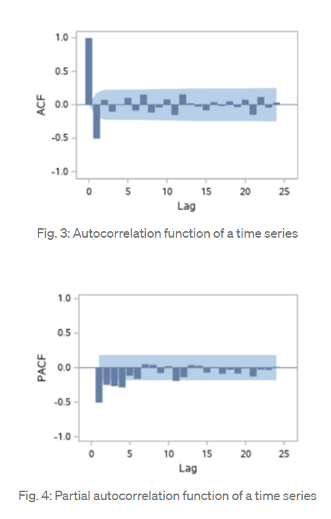
Problem 3
When doing estimation using time series, we need to consider ACF and PACF together. For AR process, we expect ACF decrease gradually while the PACF should have a sharp drop after p significant lags. On the other hand, MA has the opposite features with ACF has a sharp drop a certain q number of lags while PACF decrease gradually.
AR(1)
MA(1)

Slide 9
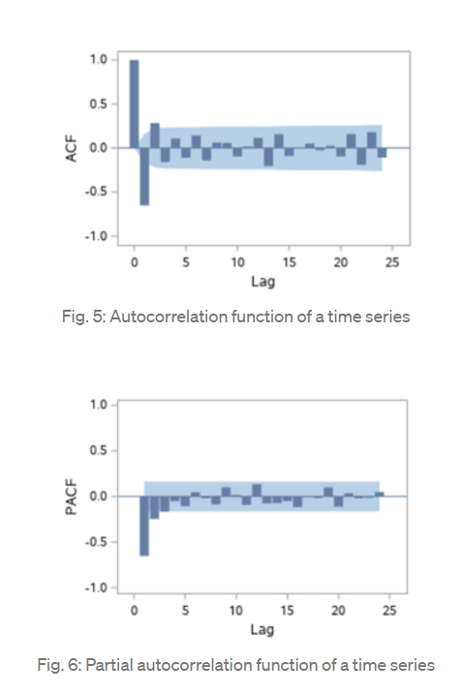
Problem 3
We can distinguish AR and MA by looking at the place where a sharp drop happens and find the appropriate model by counting how many time-lag pass when the sharp drop happens. (TowardDataScience, 2020)
AR(2)

Slide 10
Thank you!

